Slide 1
Filtering in Frequency Domain
Slide courtesy: D. Hoiem, I. Gkioulekas

Slide 2
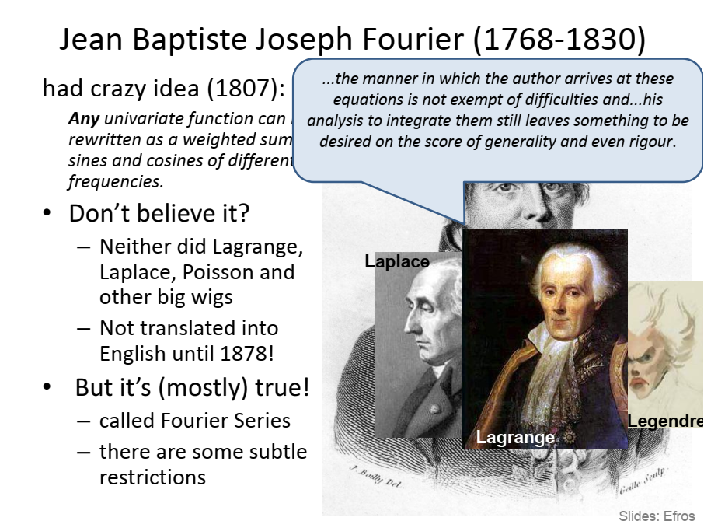

Slide 3
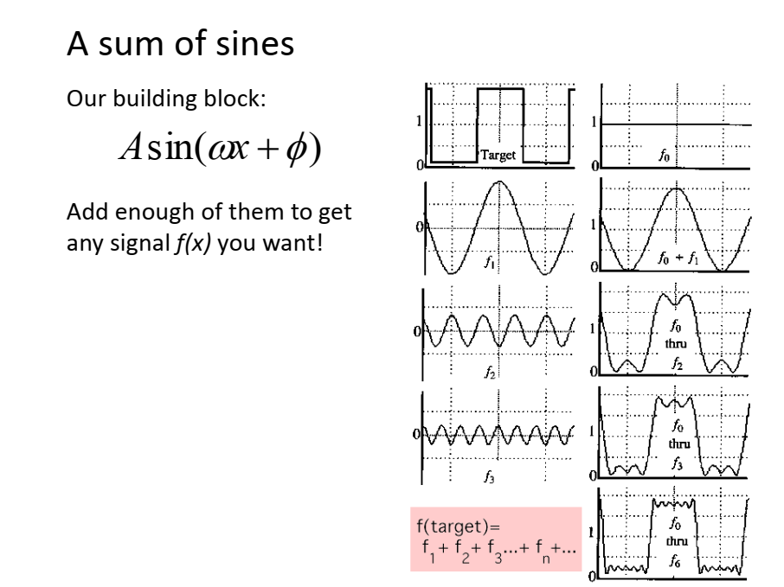

Slide 4
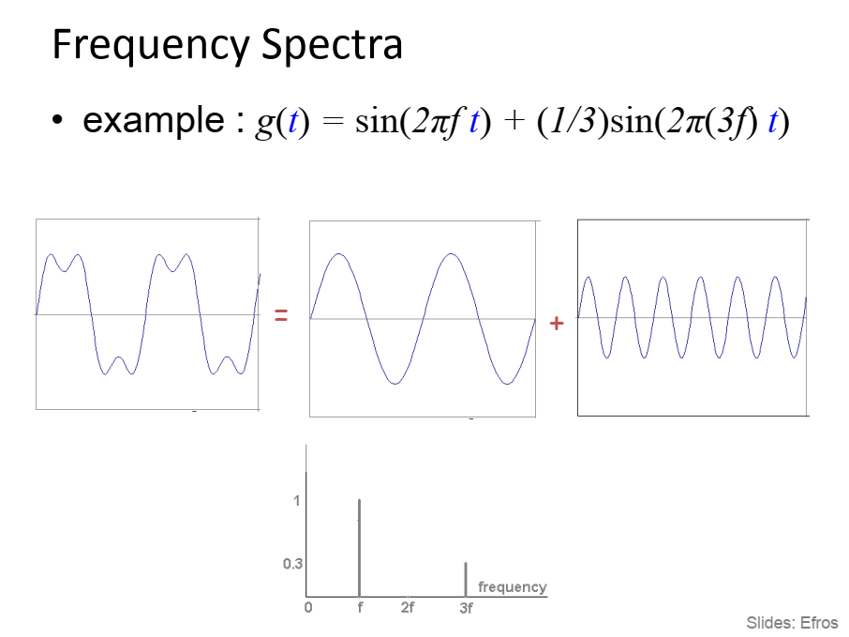

Slide 5
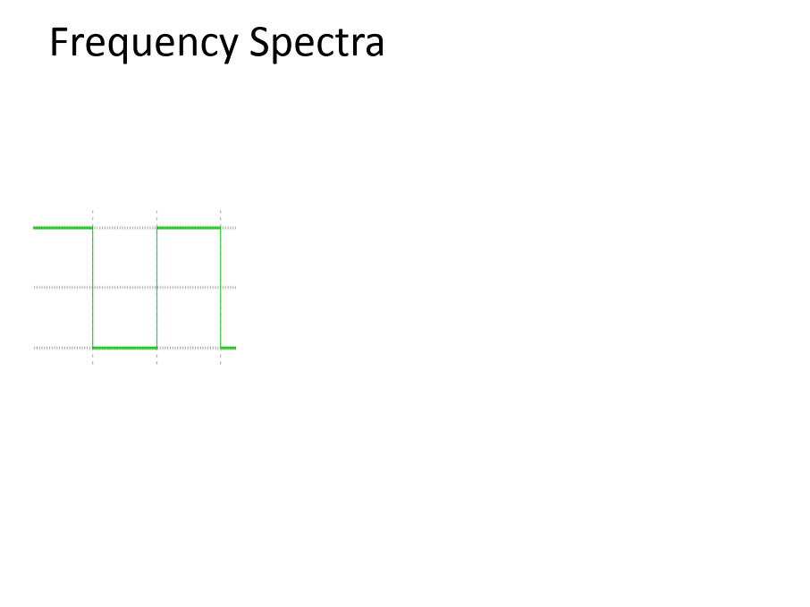

Slide 6
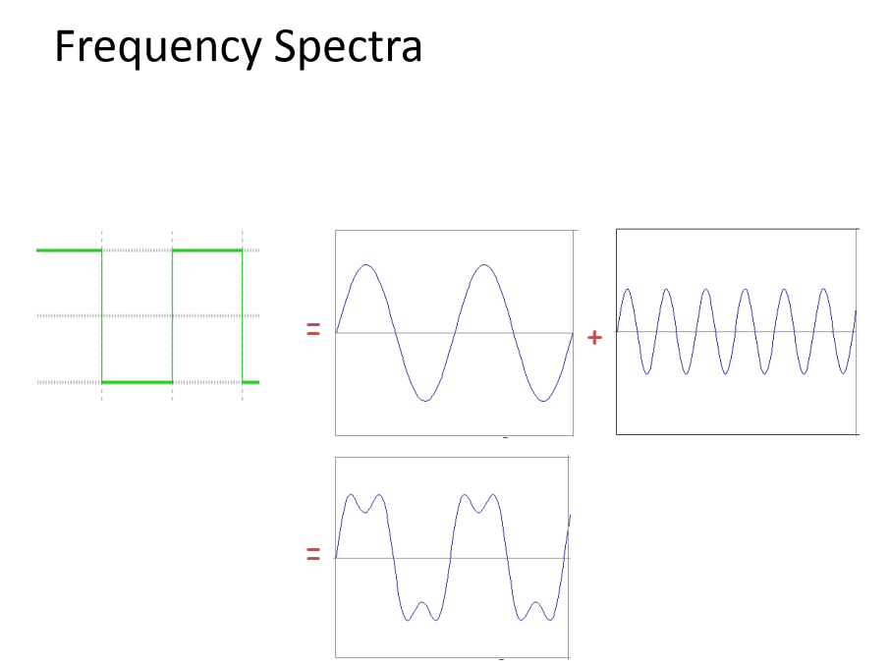

Slide 7
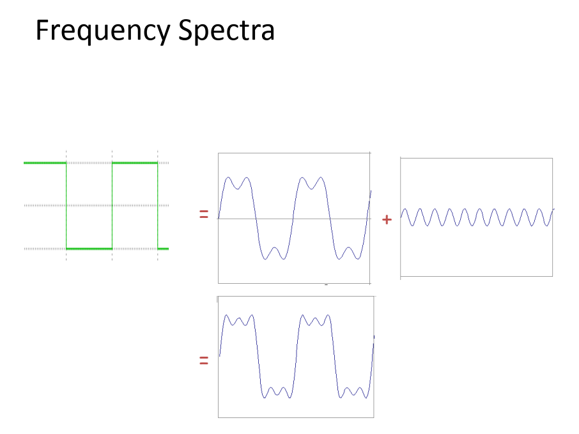

Slide 8
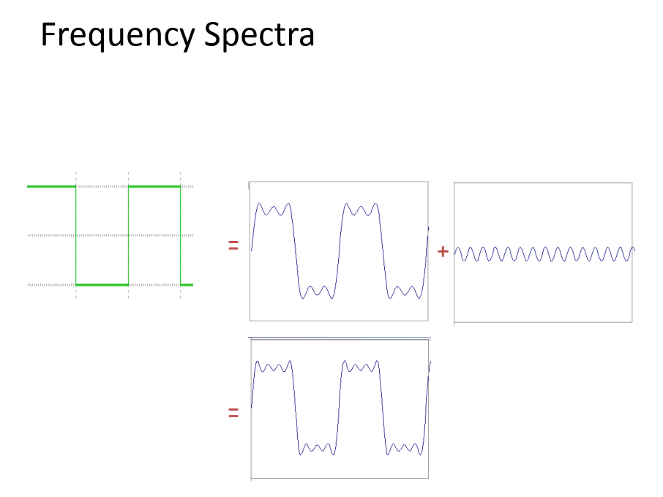

Slide 9
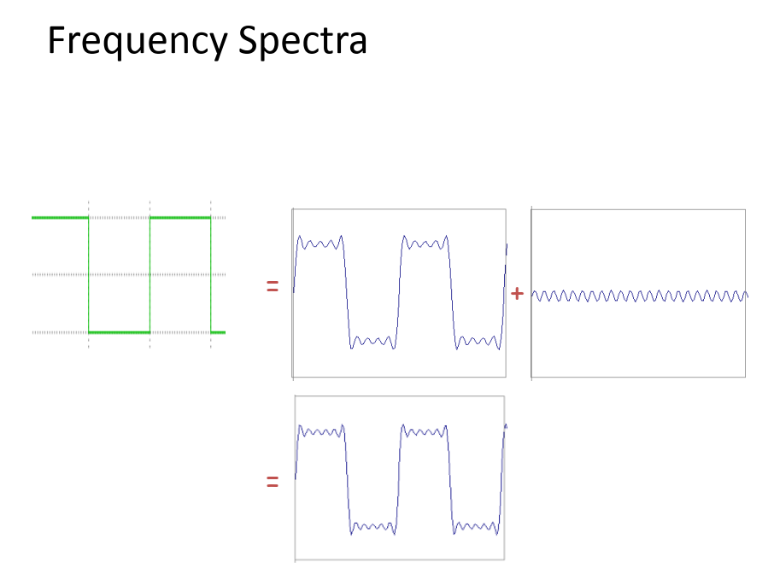

Slide 10
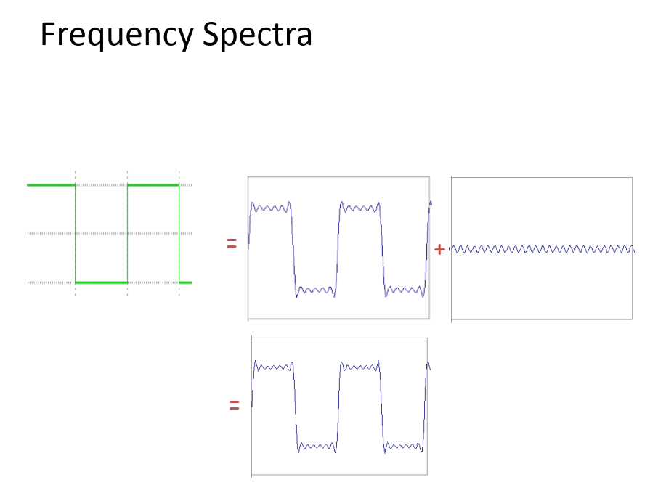

Slide 11
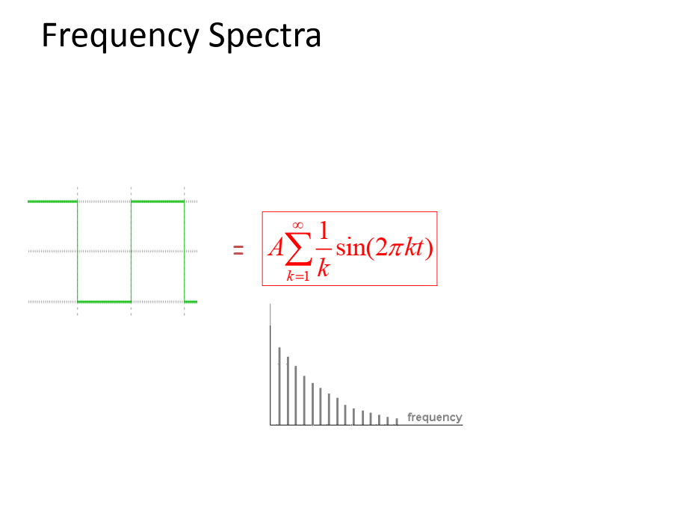

Slide 12
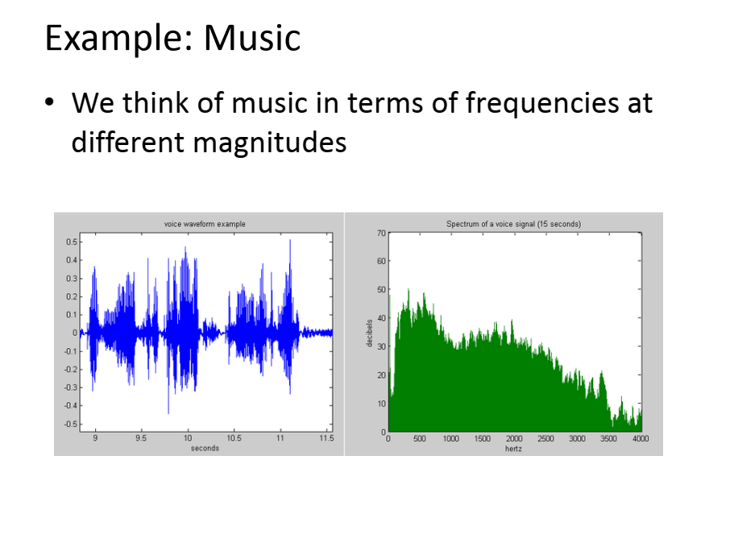

Slide 13
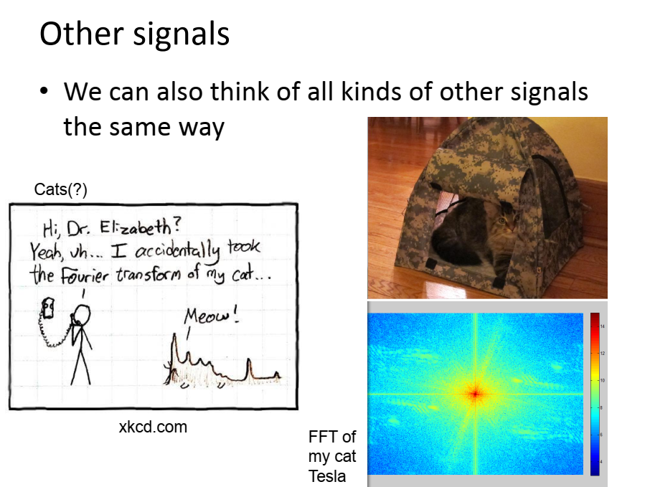

Slide 14
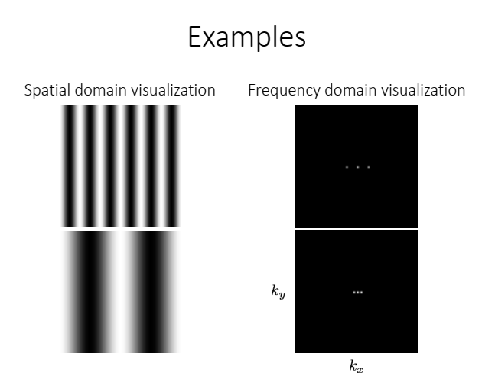

Slide 15
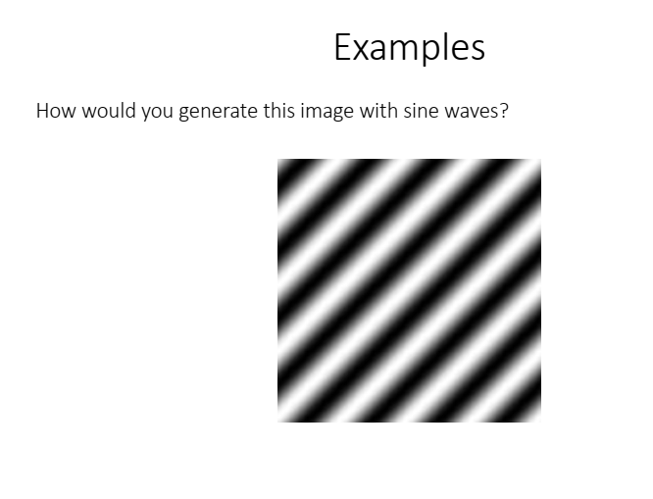

Slide 16
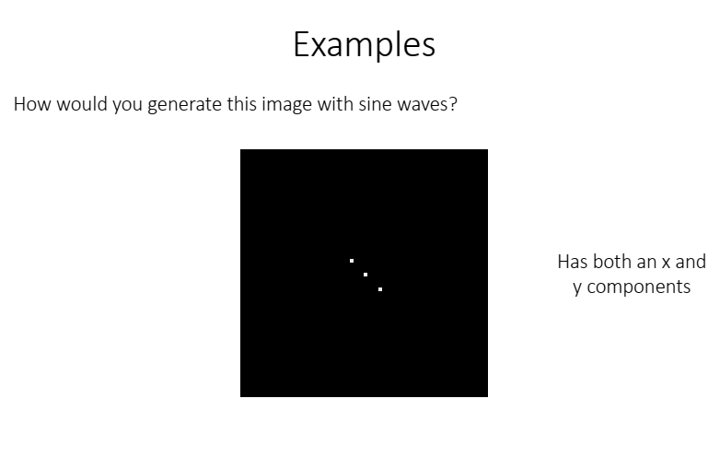

Slide 17
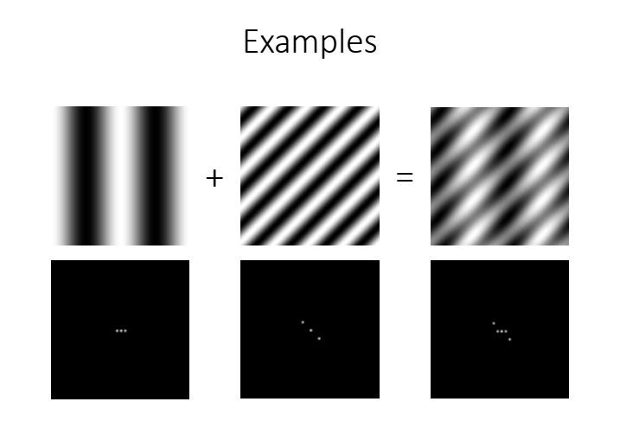

Slide 18
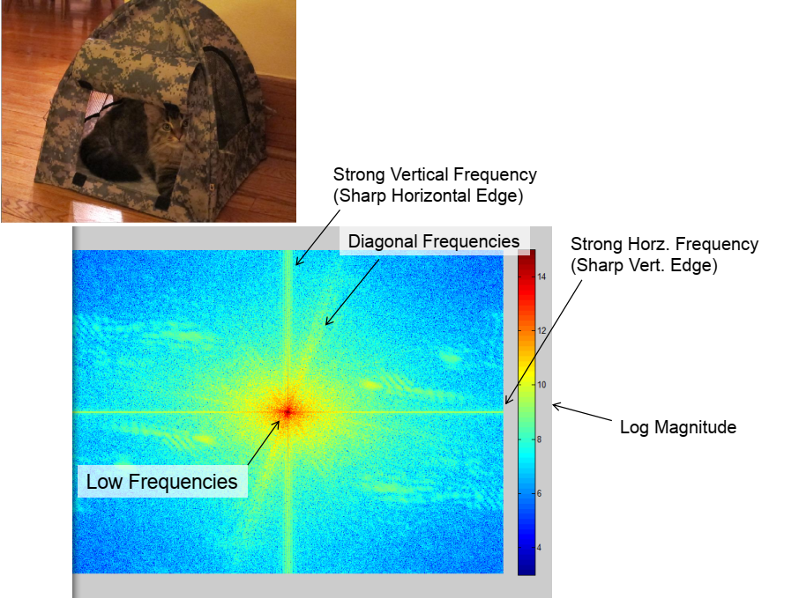

Slide 19
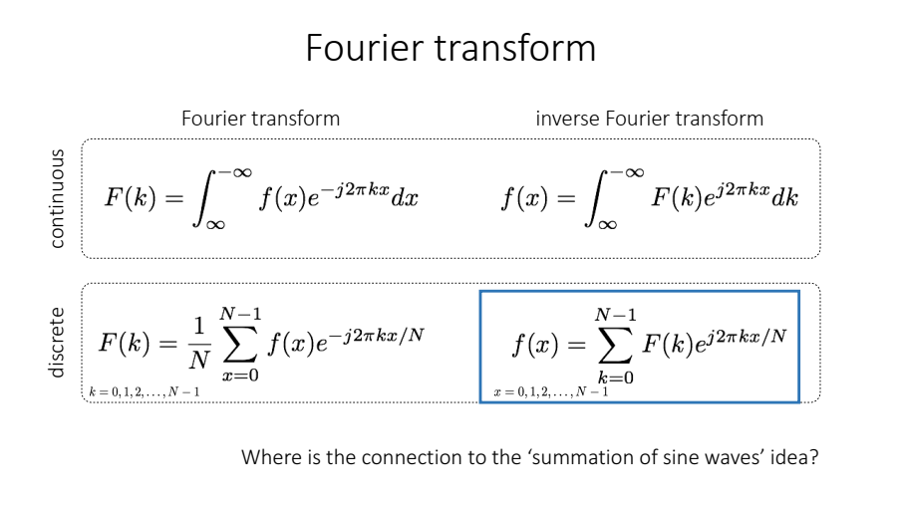

Slide 20
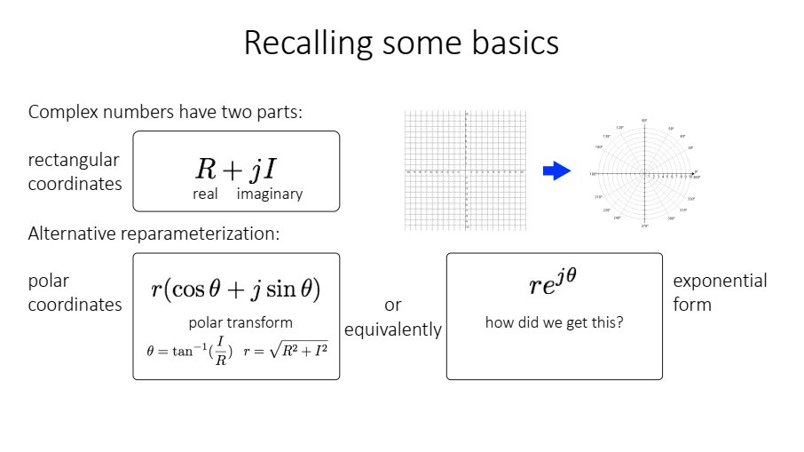

Slide 21
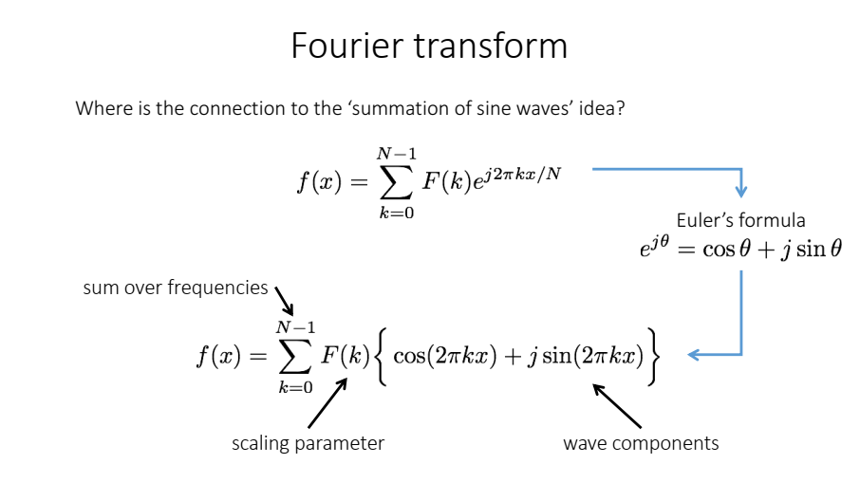

Slide 22
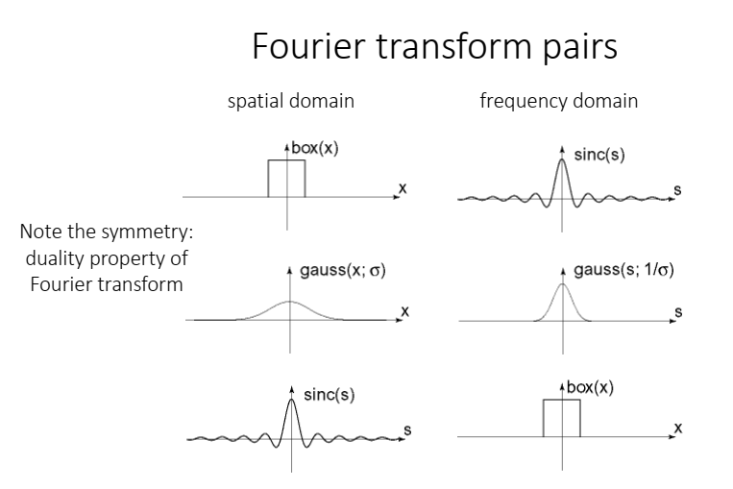

Slide 23
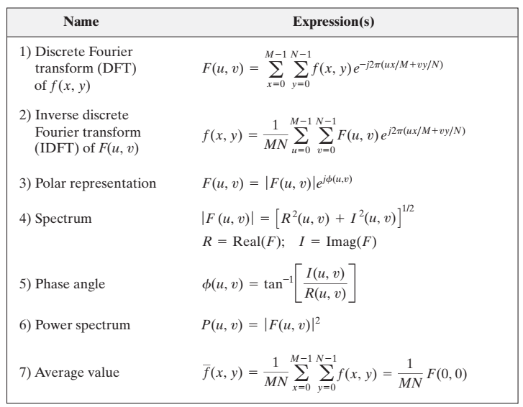

Slide 24
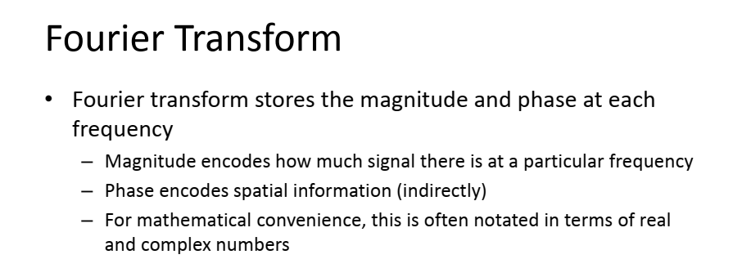
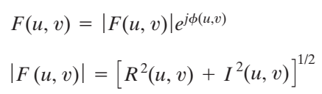


Slide 25
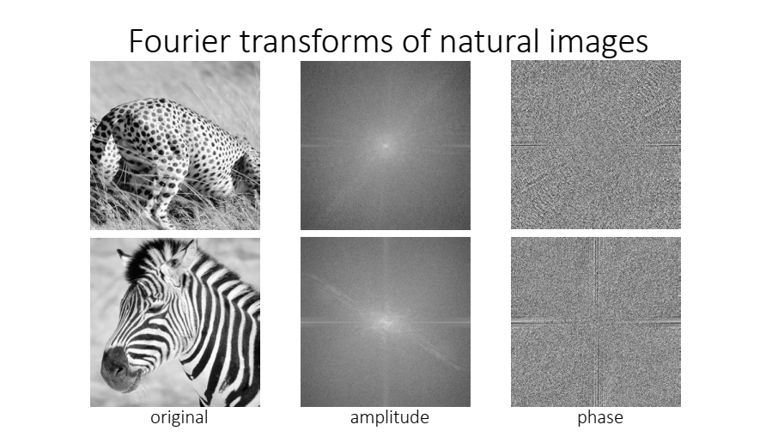

Slide 26
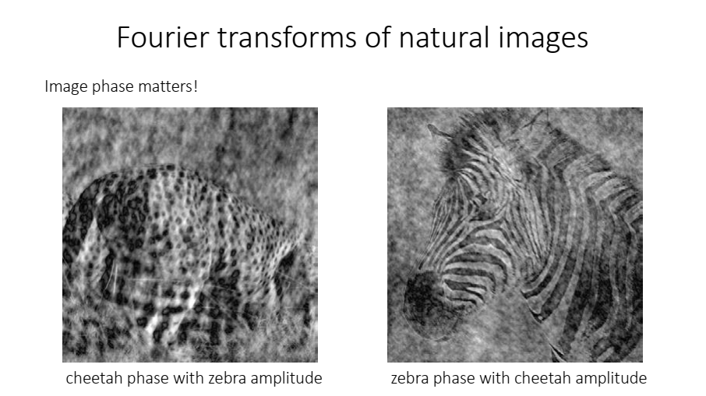

Slide 27
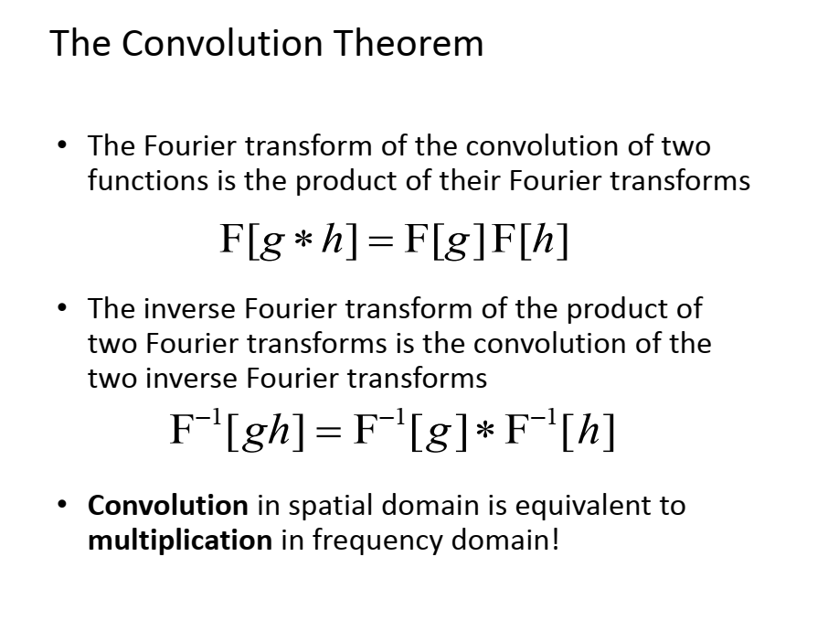

Slide 28
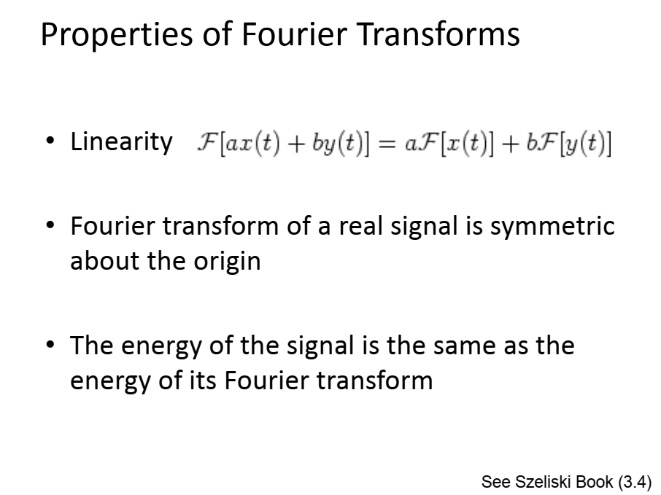

Slide 29
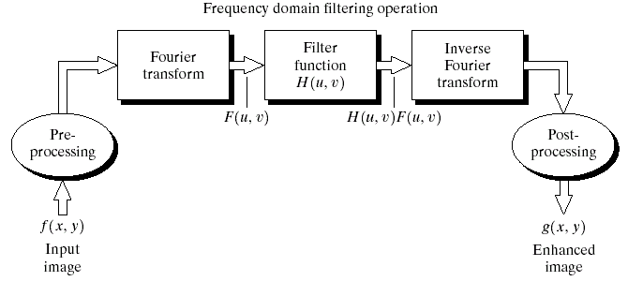
Steps for Filtering in the Frequency Domain

Slide 30
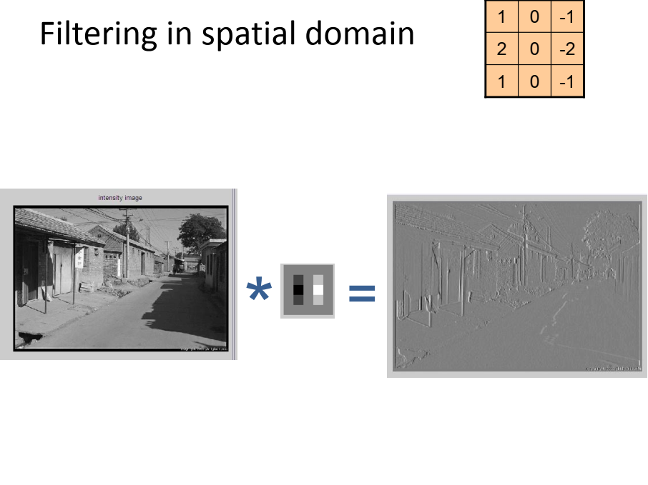

Slide 31
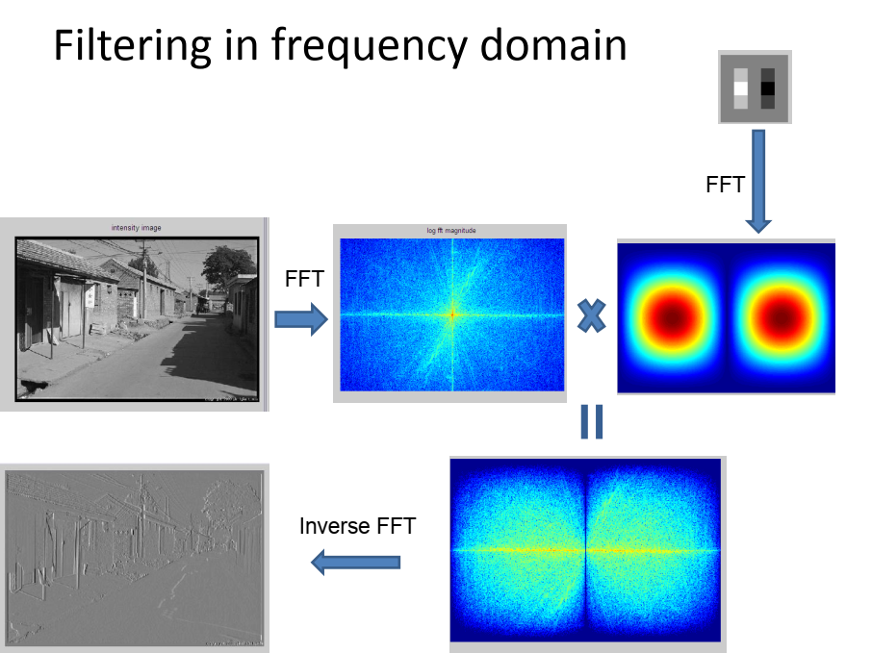

Slide 32
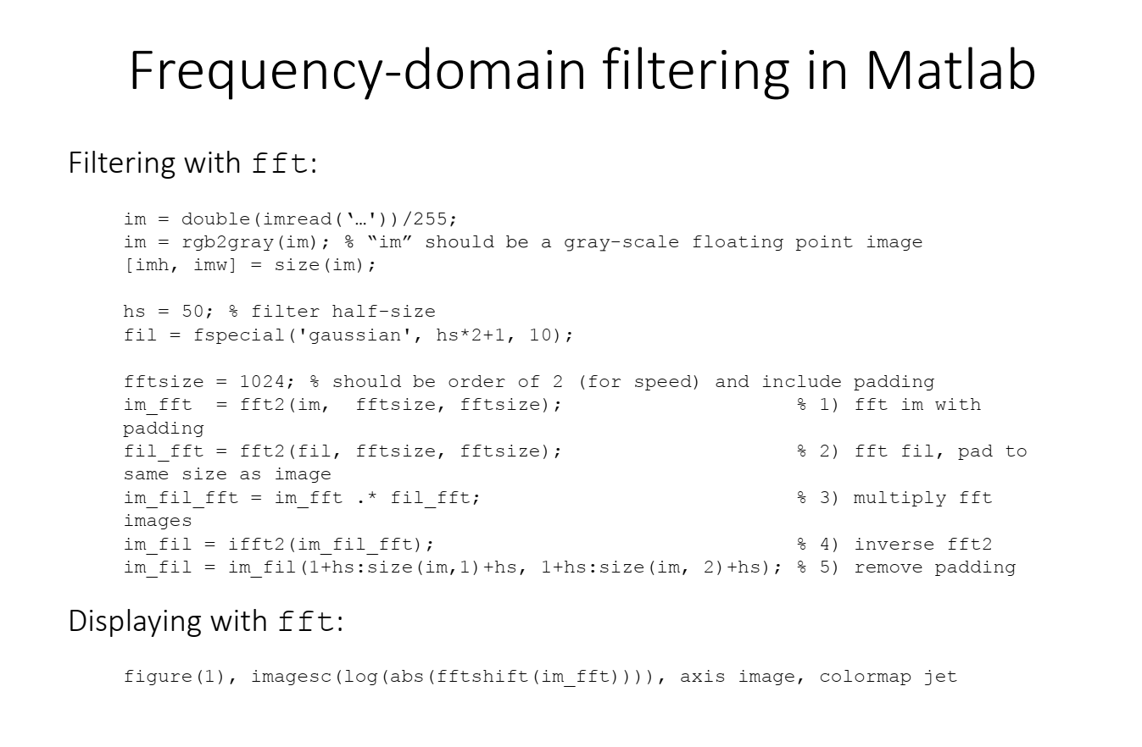

Slide 33
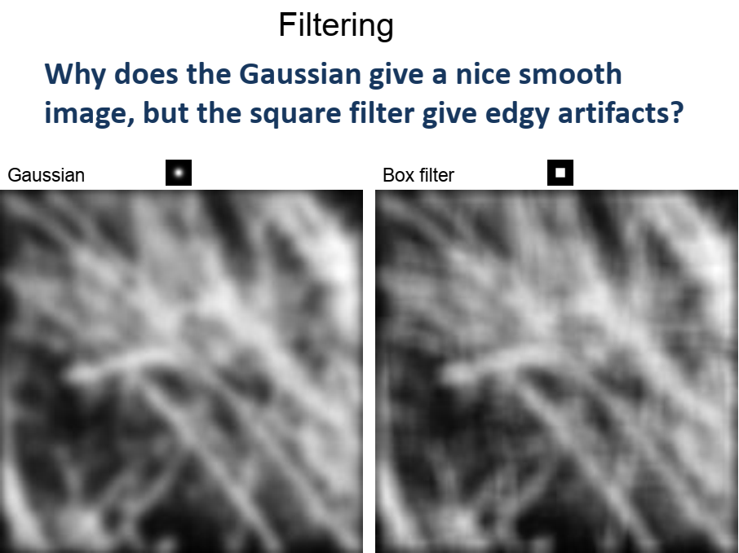

Slide 34
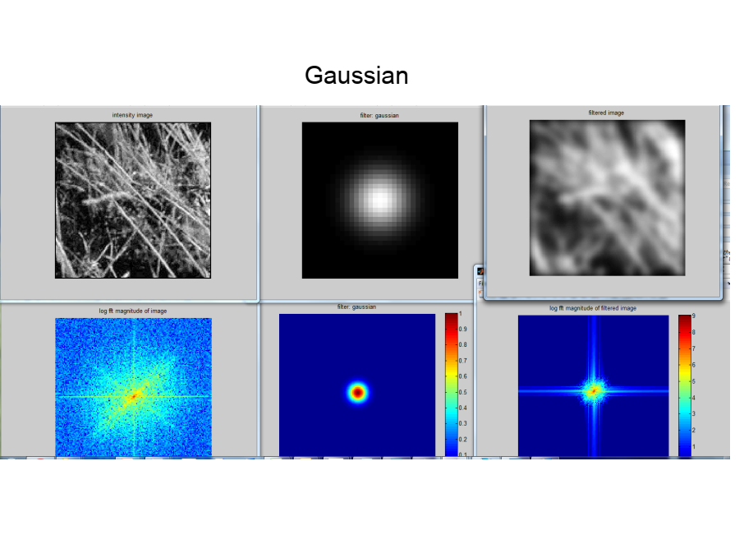

Slide 35
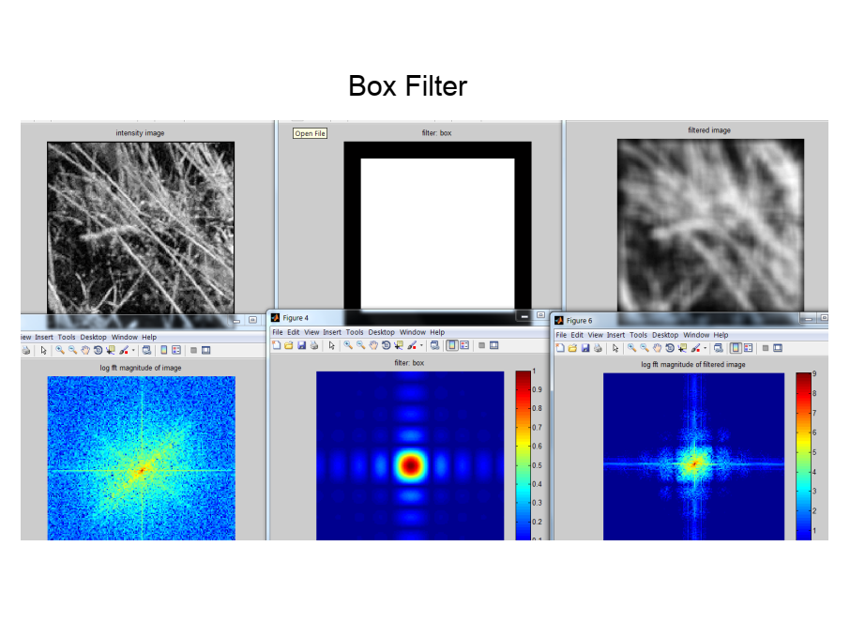

Slide 36
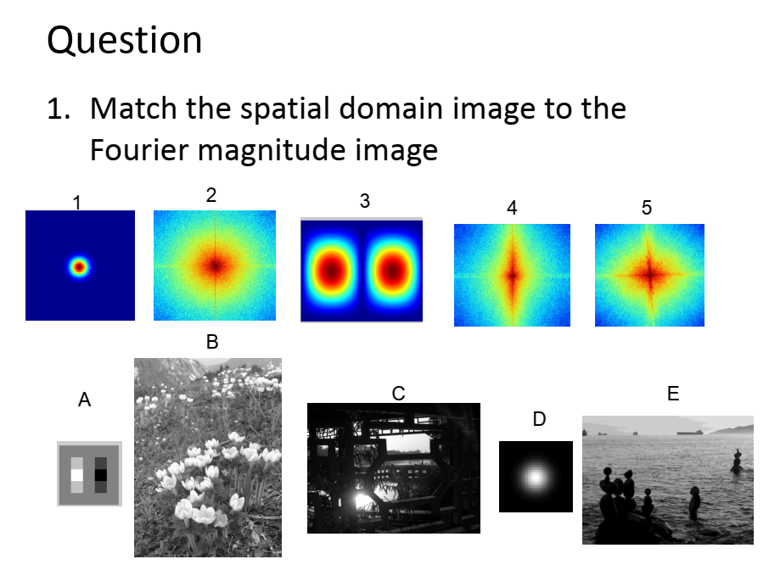

Slide 37
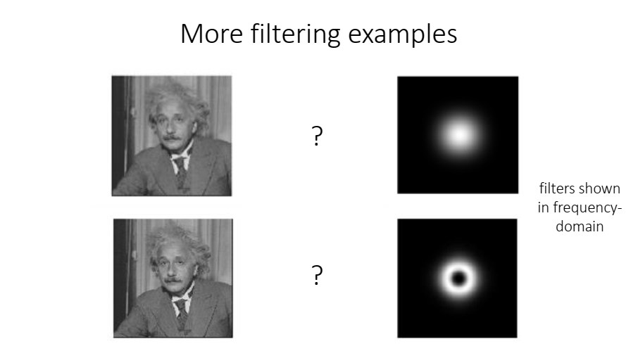

Slide 38
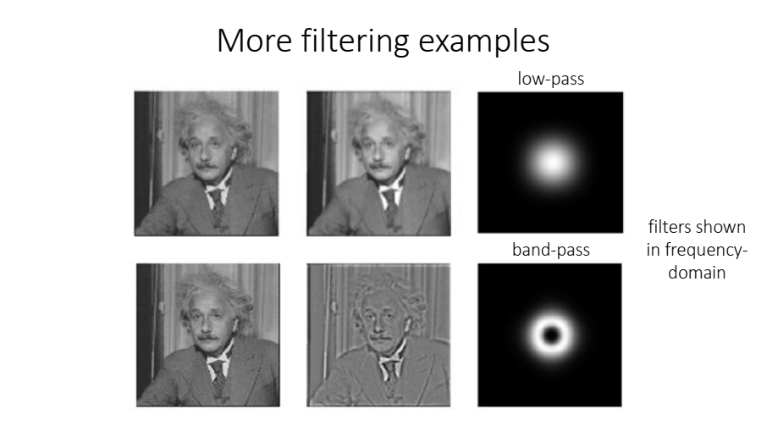

Slide 39
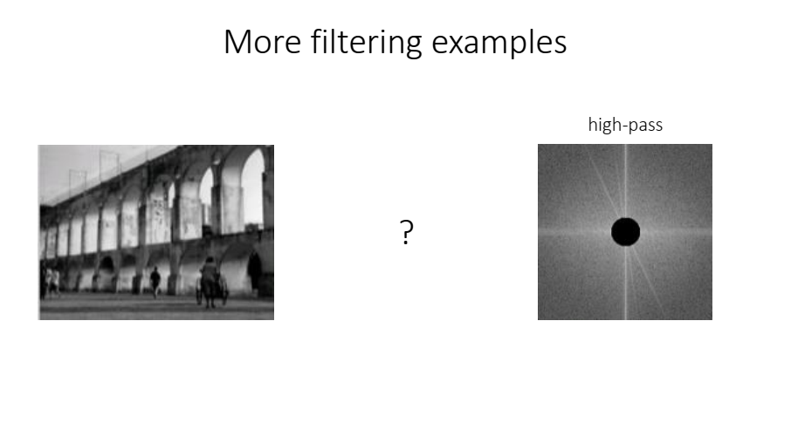

Slide 40
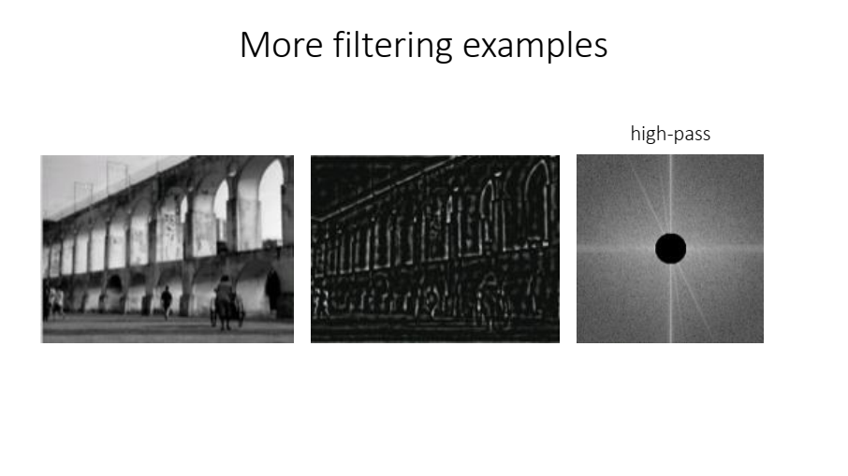

Slide 41
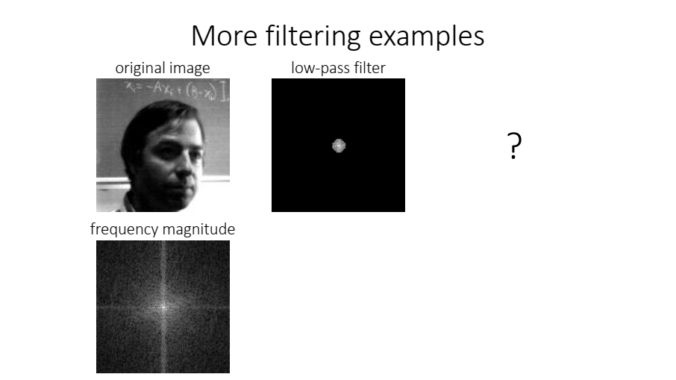

Slide 42
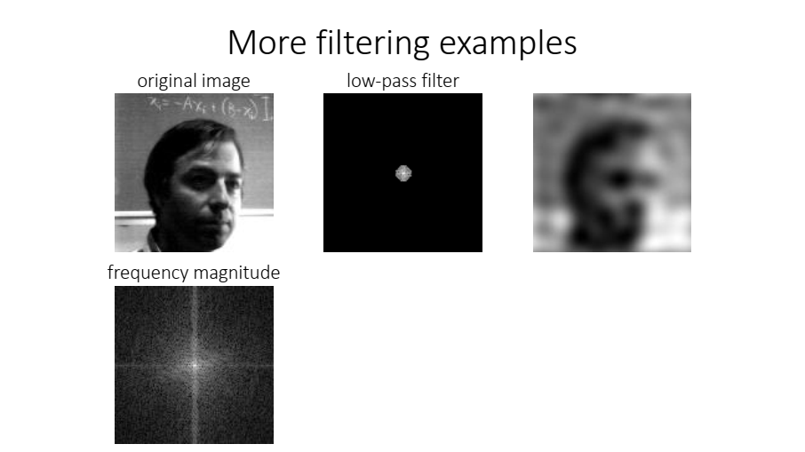

Slide 43
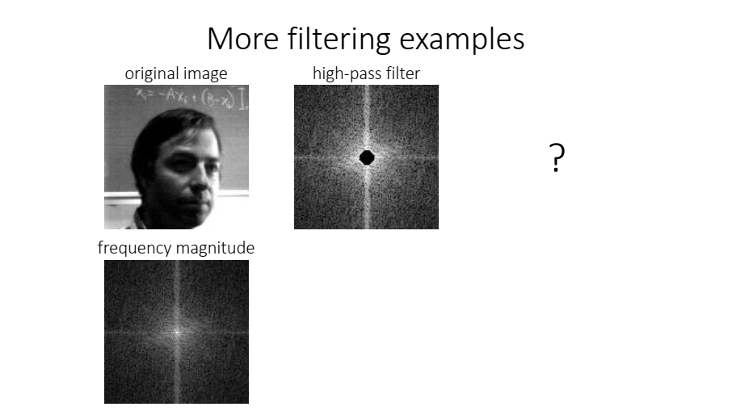

Slide 44
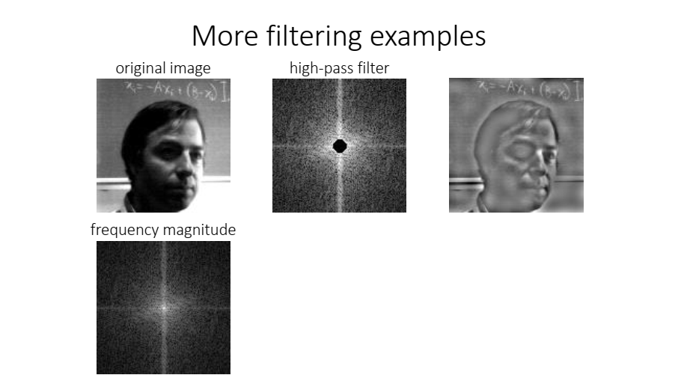

Slide 45
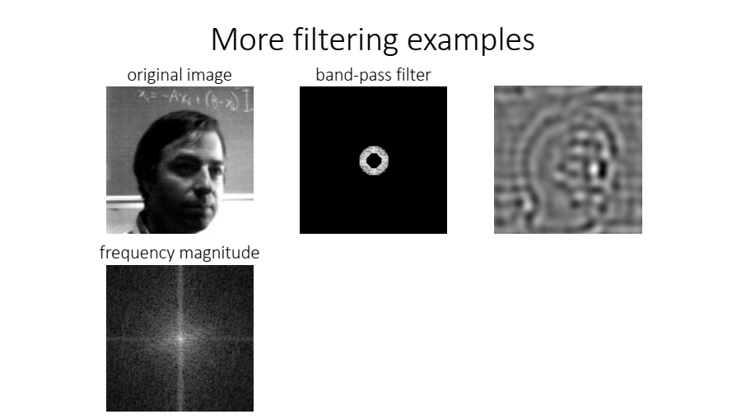

Slide 46
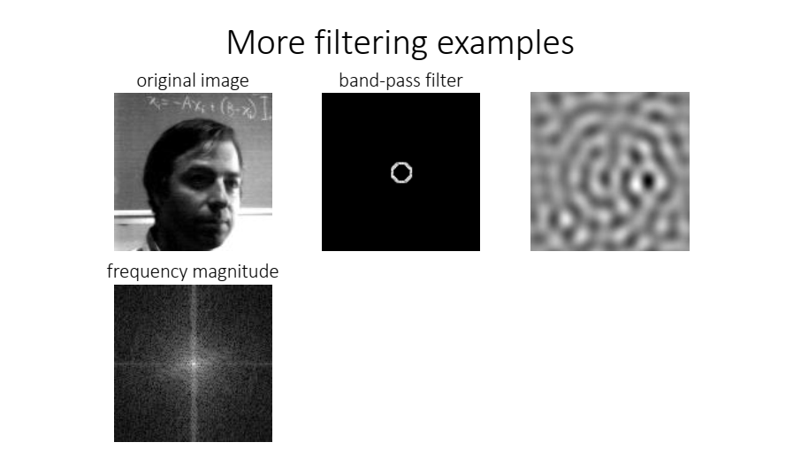

Slide 47


Slide 48
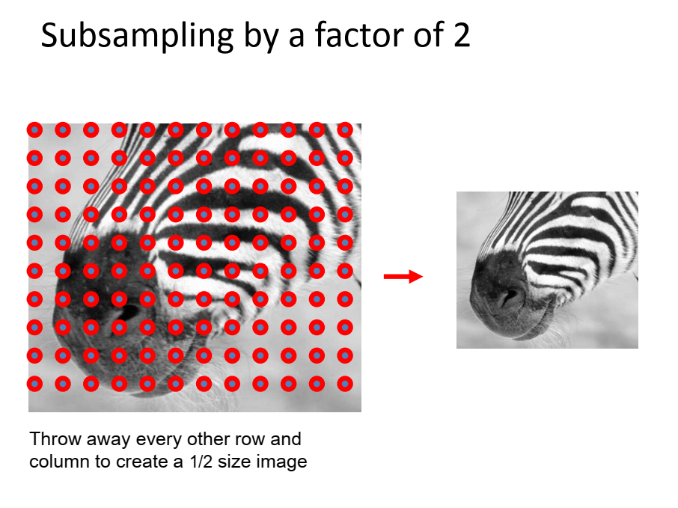

Slide 49
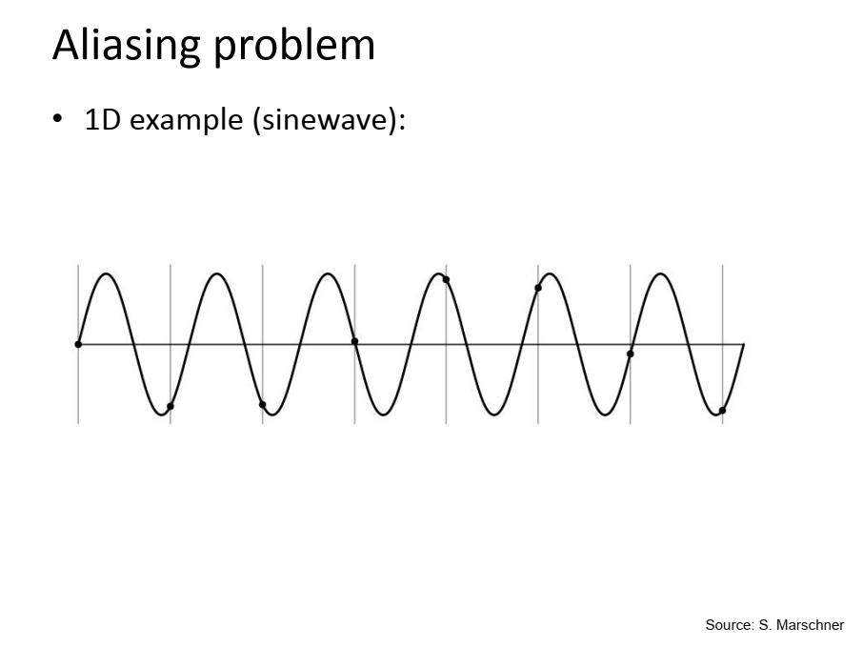

Slide 50
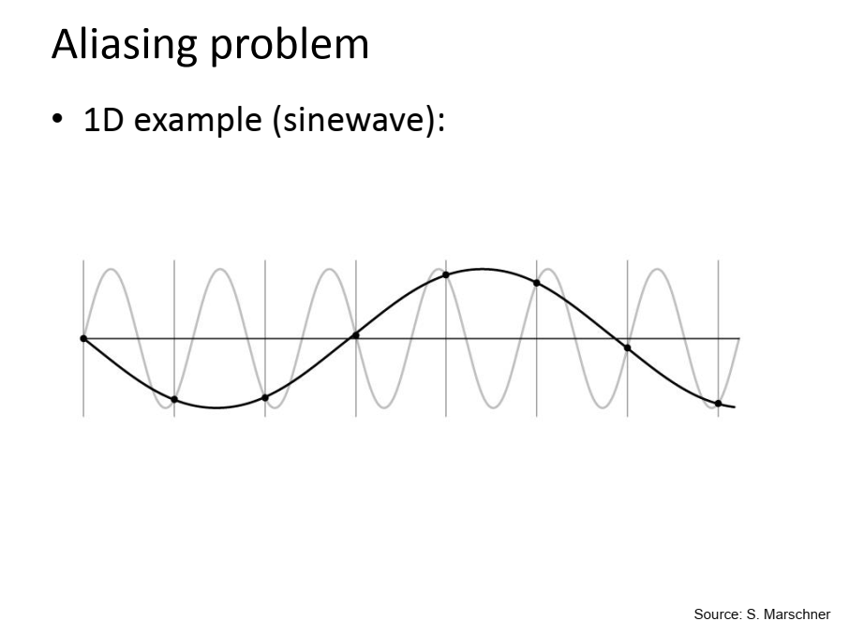

Slide 51
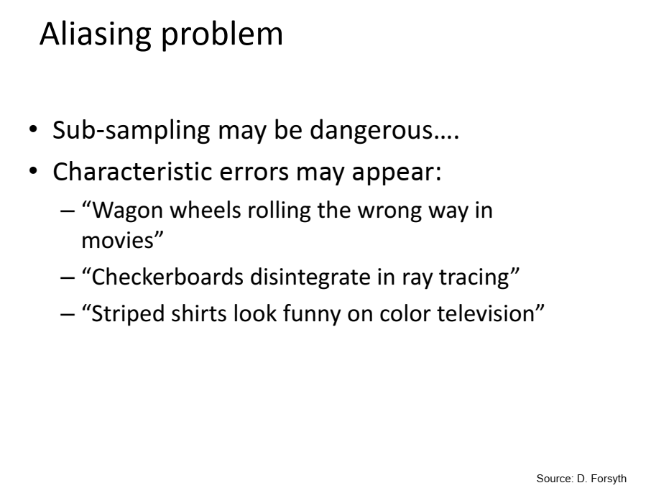

Slide 52


Slide 53


Slide 54


Slide 55


Slide 56


Slide 57


Slide 58


Slide 59


Slide 60


Slide 61


Slide 62


Slide 63


Slide 64


Oriented pyramids
Oriented pyramids: represents image information at a particular scale and orientation

Slide 65

Laplacian & oriented pyramid
Notes:
And this shows a (rough) representation of what happens in FT space when we form
pyramids. In the Laplace pyramid, each layer represents a range of frequencies ---an
annulus in FT space --- or, roughly, a scale. We’d actually like to break out each annulus
into an orientation, which is equivalent to a wedge. We won’t discuss the design of the relevant filters in detail, just note that this is possible. If we do this, we have an oriented pyramid.

Slide 66

Gabor filters

Slide 67

Gabor filters

Slide 68


Slide 69

Gabor filters look like Fourier basis elements that are multiplied by Gaussians, meaning that a Gabor filter responds strongly at points in an image where there are components that locally have a particular spatial frequency and orientation (the response is large when the spatial frequency of the bars roughly matches that windowed by the Gaussian in the Gabor filter kernel)

Slide 70


Slide 71


Slide 72


